Slide 1
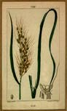






LARGE-SCALE PHENOTYPING OF A COLLECTION OF T-DNA INSERTION LINES OF RICE
M. Lorieux – Rice Genetics 6 / ISRFG 7
Manila, Nov. 18, 2009
Notes:
I will start with functional genomics, and I will give you some informations about a project that involves CIAT, IRD (a French public research institute that belong to Agropolis) and Génoplante, which is a Consortium of public and private companies
This project aims at a Phenotypic characterization and multiplication of a rice mutant T-DNA collection

Slide 2
BACKGROUND & PURPOSE
T-DNA (transgenic) insertions generate gene knockout
Location (i.e. knocked gene) of insertion is determined for each line by sequencing
Establish relation between knocked gene and phenotype
Forward genetics: phenotype ➔ gene
Reverse genetics: gene ➔ phenotype
Look at the entire collection for phenotypes (several thousands of lines)
Phenotypic database coupled with FST database
Seed multiplication

Slide 3
COLLECTION FIGURES
Prepared at Cirad (E. Guiderdoni’s group)
Cultivar Nipponbare
Agrobacterium-mediated
Several T-DNA constructs (enhancer trap)
30,000+ insertion lines generated
27,555 T-DNA FSTs (17,000+ discrete loci)
14,355 Tos 17

Slide 4
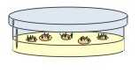
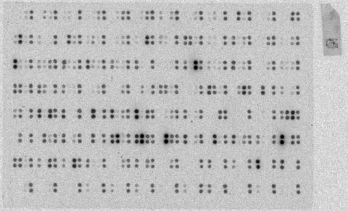
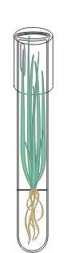
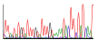
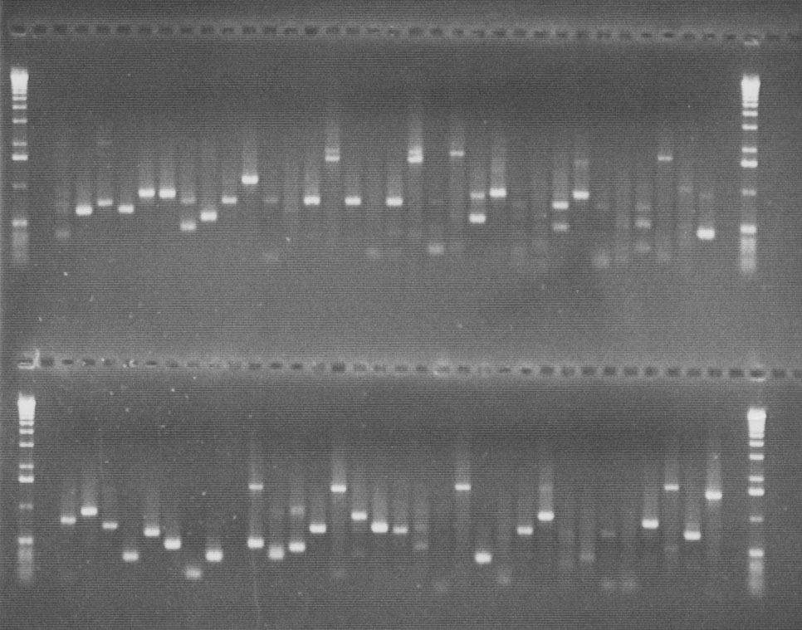

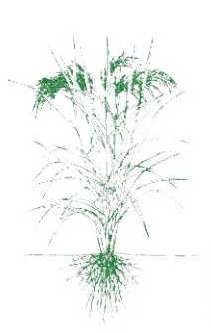
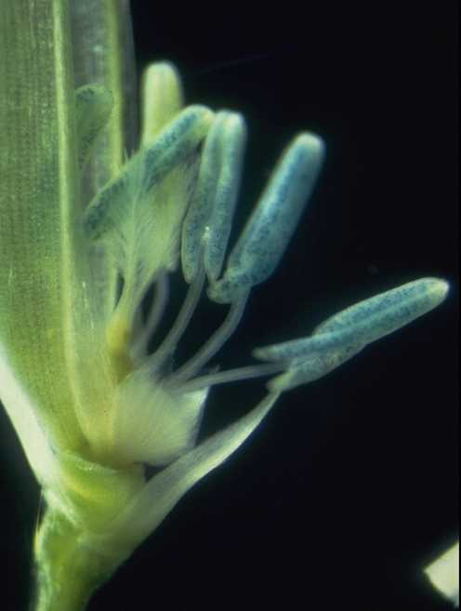
Agrobacterium-mediated production of T-DNA plants
Display of flanking regions (T-DNA, Tos17 ) on filters
Screening through hybridization with candidate sequences or cDNA populations
Walk PCR-based amplification of flanking regions (T-DNA, Tos17 )
Sequencing T-DNA left border flanking regions
Sequence DB
Blast T-DNA FSTs against rice genome, ESTs, proteins..
Oryza Tag Line
Evaluation of T1 progeny for :
•Abiotic stress • Embryogenesis • Grain filling • Biotic stress • Non targeted phenotypes
Pheno-type DB
GUS assays on vegetative and reproductive organs of T0 plants
Cold storage and distribution of T2 seeds

Slide 5
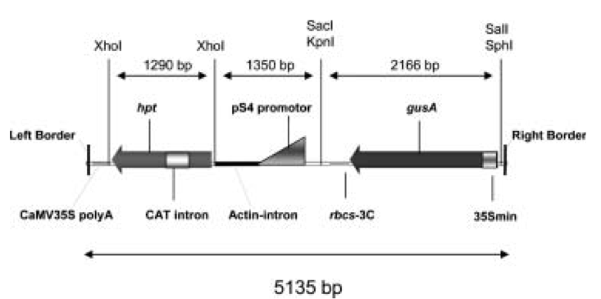
EXAMPLE OF T-DNA
Schematic representation of the T-DNA of the binary vector p4978
Sallaud et al – Theor Appl Genet 2003

Slide 6
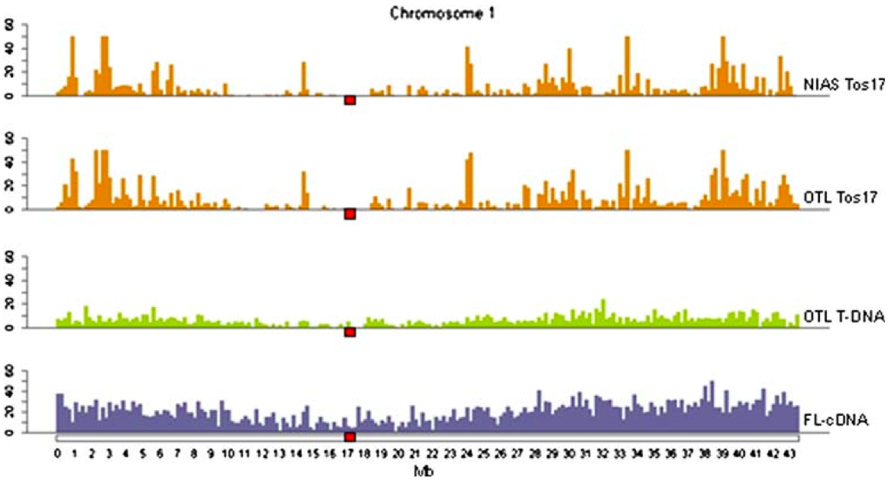
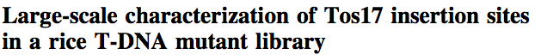
T-DNA VS. TOS17 INSERTIONS
Piffanelli et al – Plant Mol Biol 2007

Slide 7
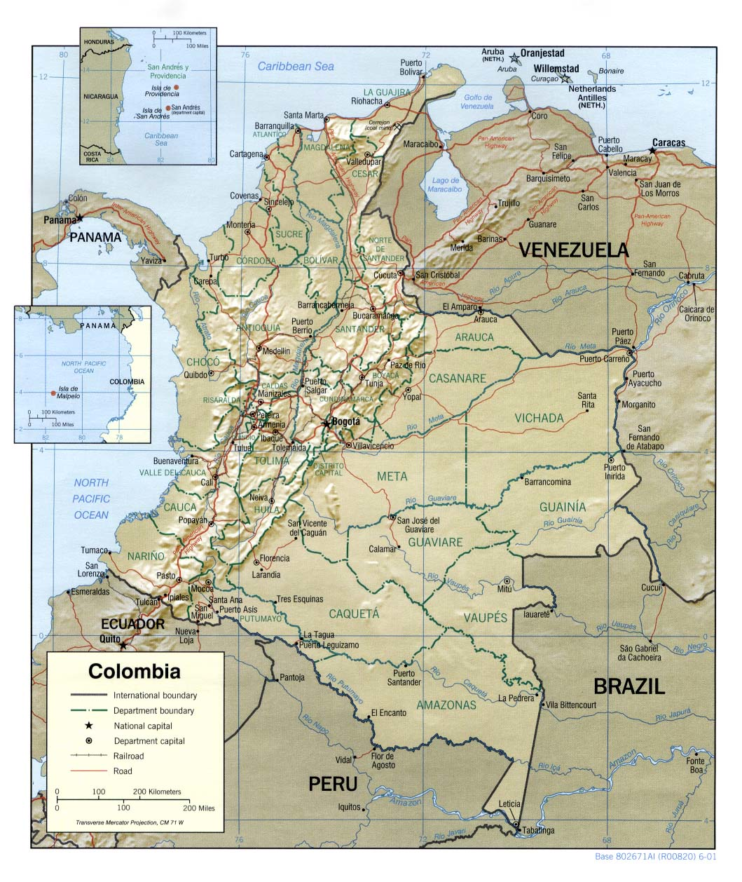
PHENOTYPING AT CIAT
Screenhouse, field & lab facilities
Good environment climate/diseases/photoperiod for Nipponbare
Authorization to grow GMO rice in the field at CIAT HQs
Cali

Slide 8
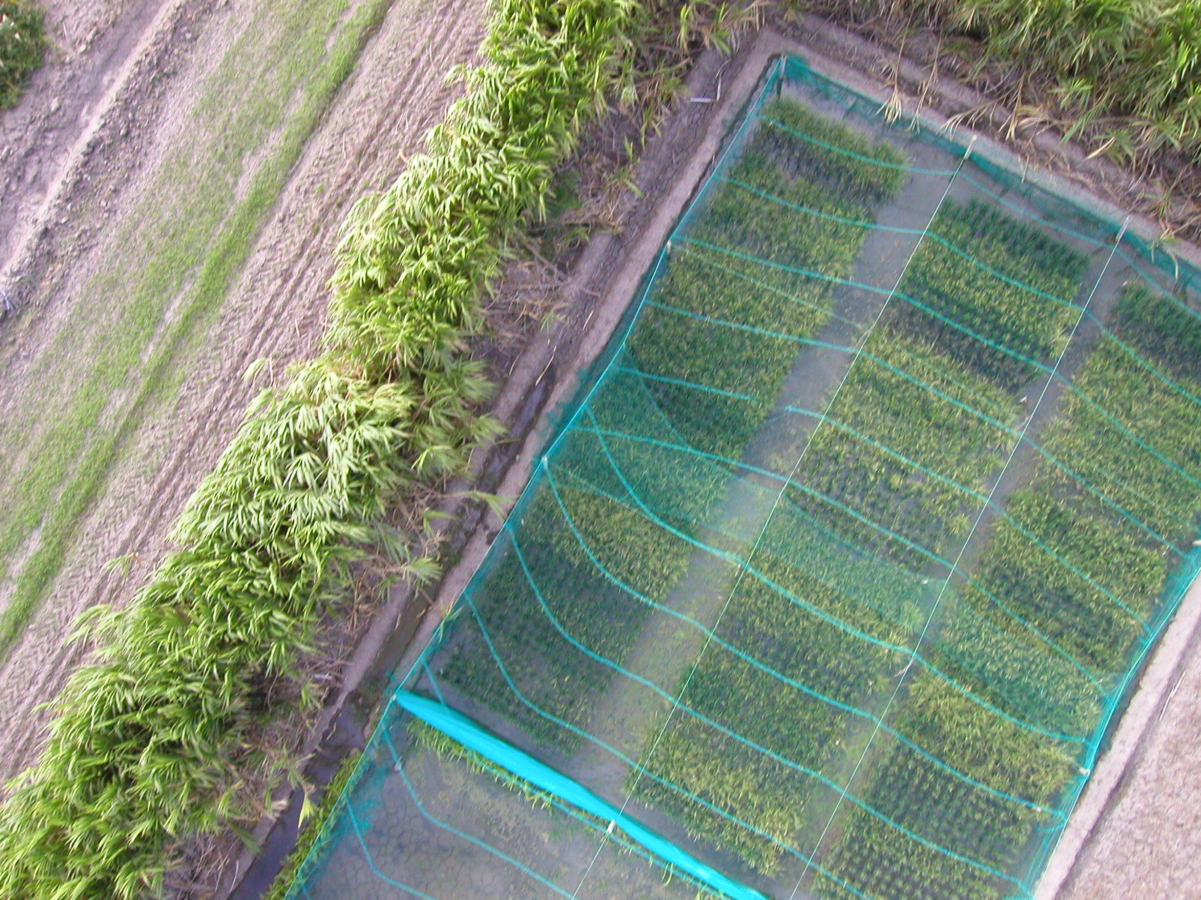
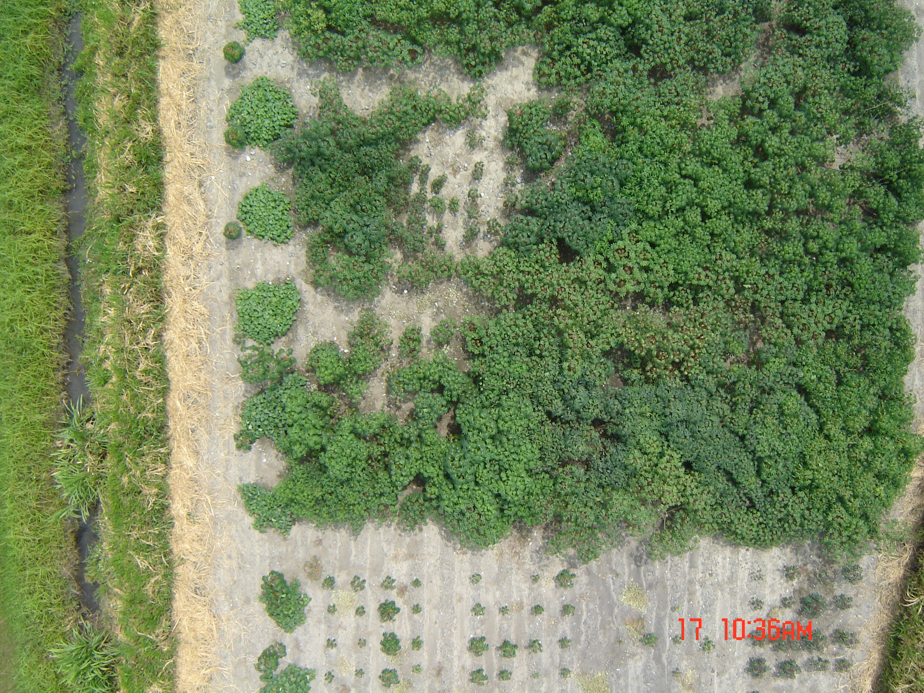
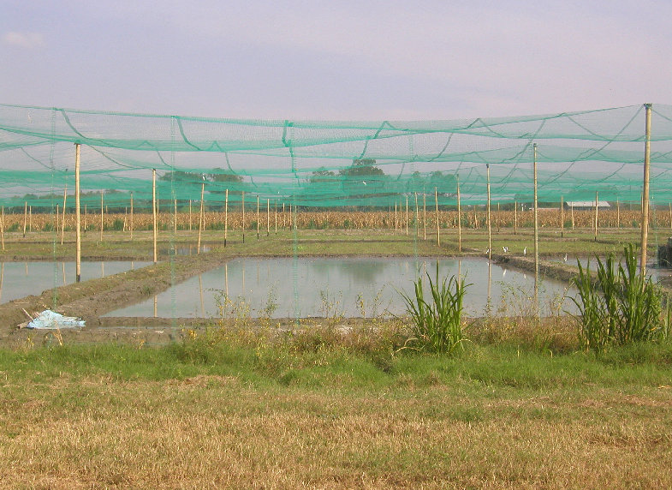
CIAT TRANSGENIC CONFINED FIELD TRIALS
RHBV
3 Cassava biosafety trials
Rice T-DNA mutants

Slide 9
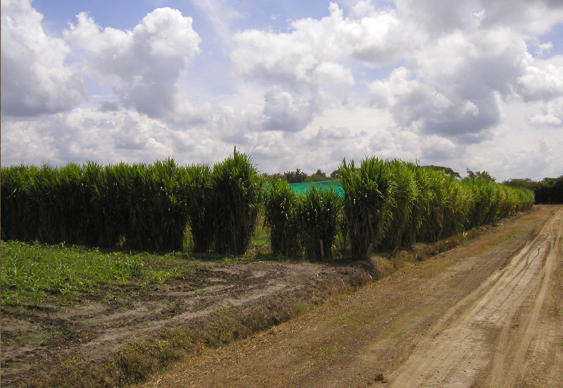
FIELD SETUP

Slide 10
TRAITS
Germination rate
Viability, vigor, senescence
Morphology
Pigmentation/coloration
Heading & ripening
Panicle & seed traits
Lesion mimics
Etc.
Notes:
The idea is to analyse the largest possible range of traits.

Slide 11
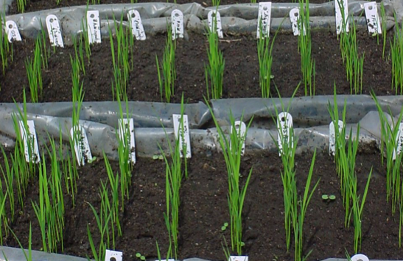
SCREENHOUSE OBSERVATIONS

Slide 12
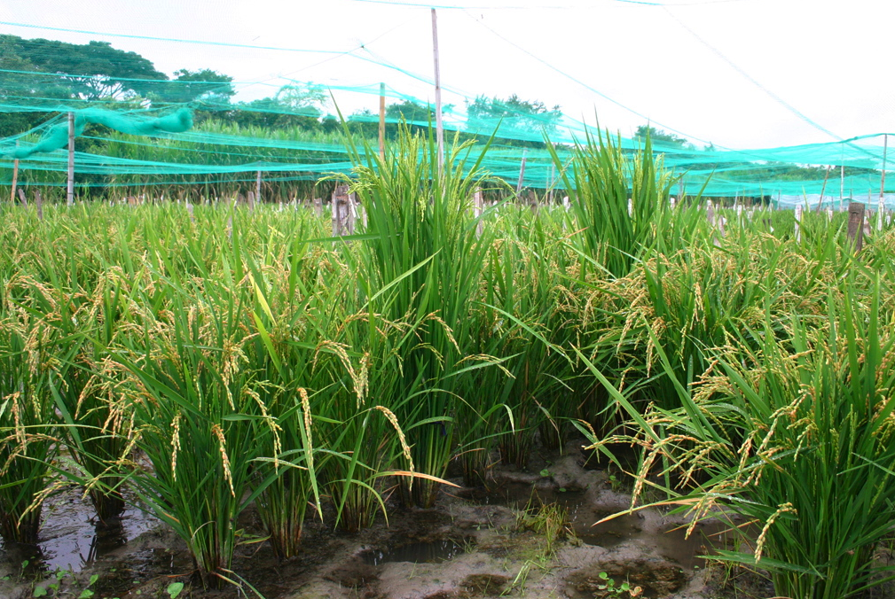
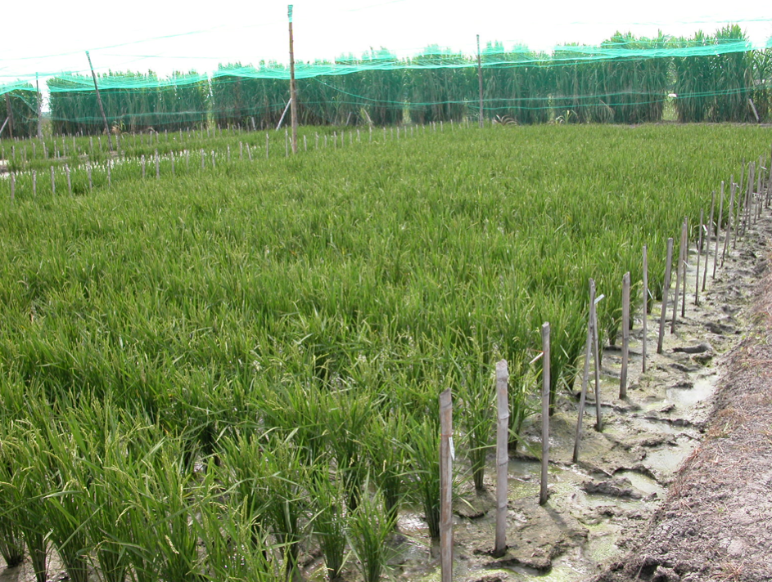
FIELD SCREENING

Slide 13
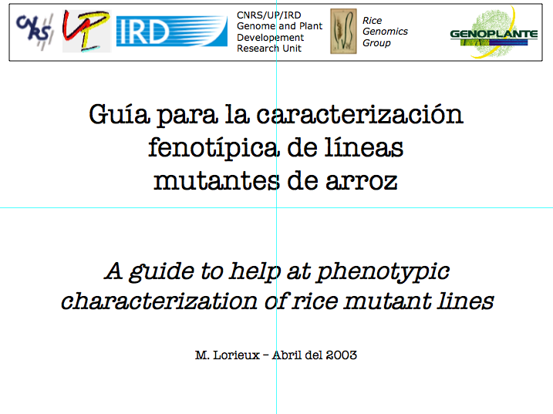
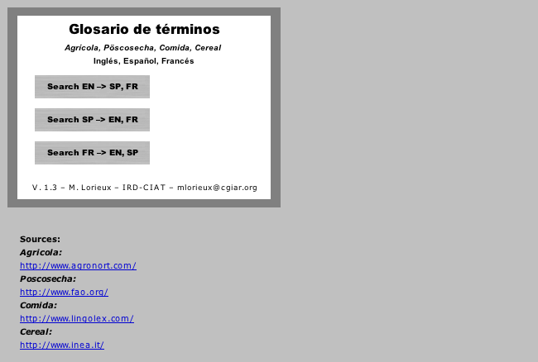
PHENOTYPING GUIDE
GLOSSARY OF TECHNICAL TERMS

Slide 14
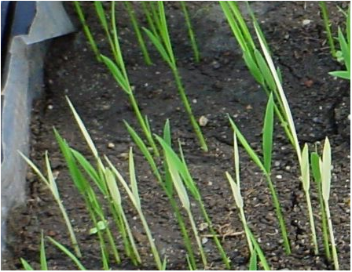
Albino

Slide 15
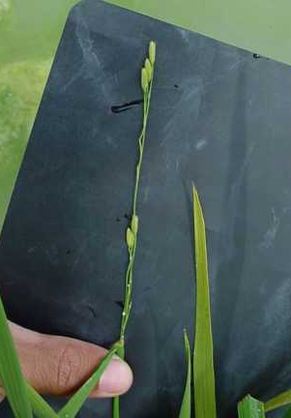
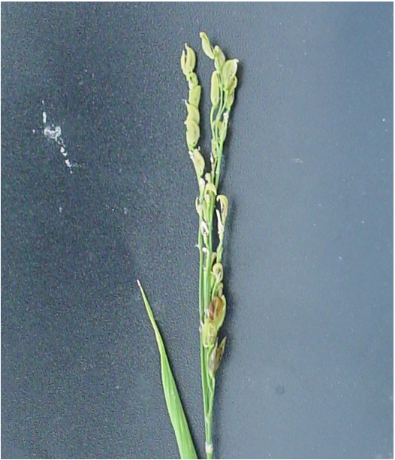
Terminal spikelet
Panicle with only terminal spikelet, flag leaf rolled at its base

Slide 16
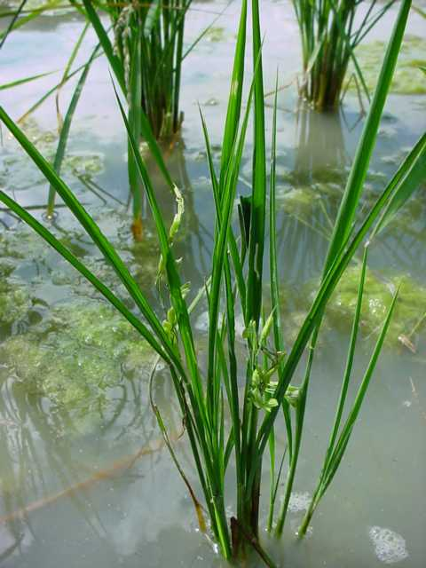
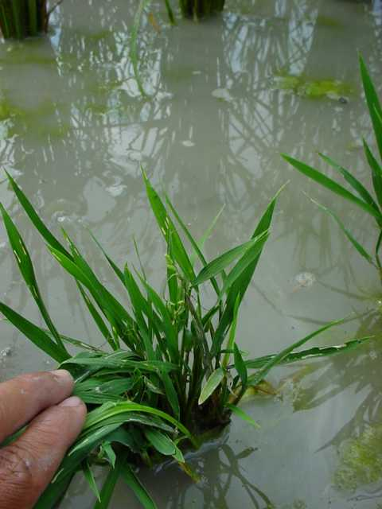
Dwarf

Slide 17
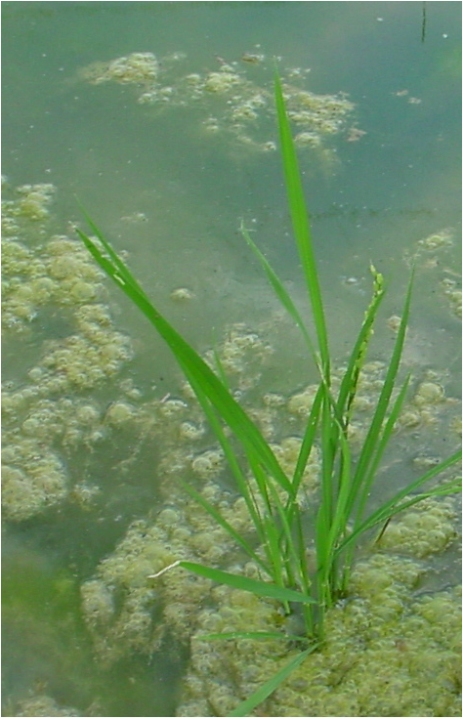
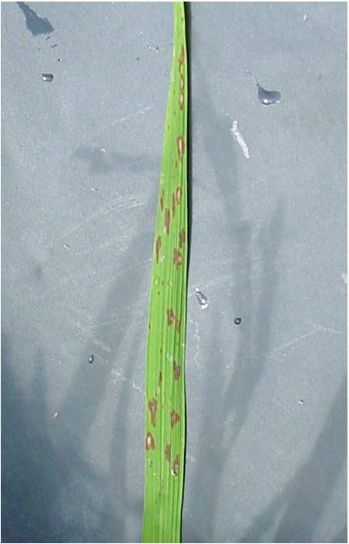
Semi-dwarf - hooked spikelets
Semi dwarf (-25%) in proportion, delayed flowering. Sterile. Panicles with hooked spikelets

Slide 18
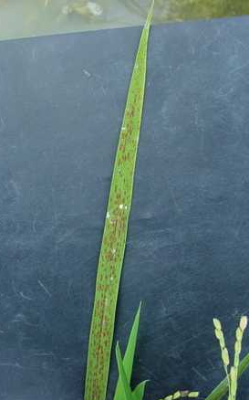
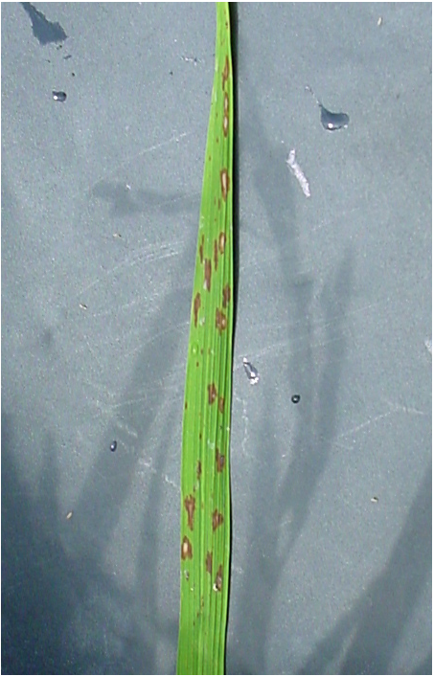
Lesion mimics
Dark red spots in some leaves
Lesion mimics, rice blast-like. Wavy leaves, reduced spikelets, fine leaves

Slide 19
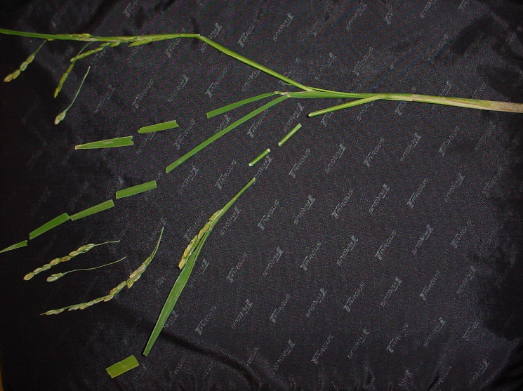
Brittle

Slide 20
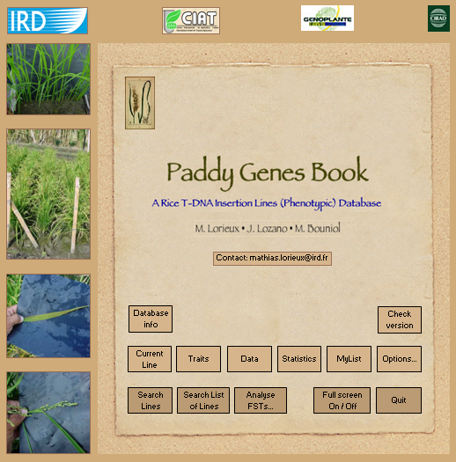
PHENOTYPIC DATABASE

Slide 21
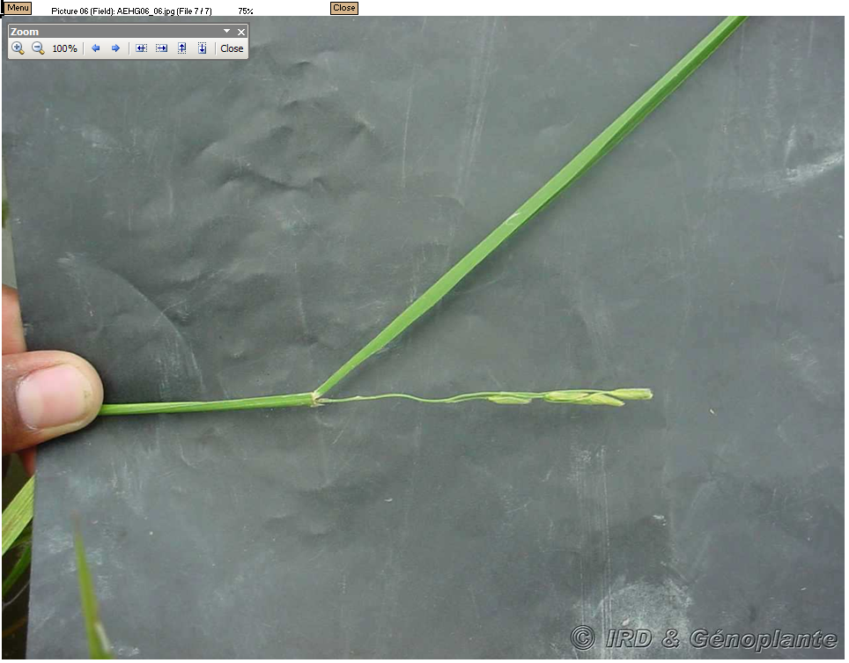
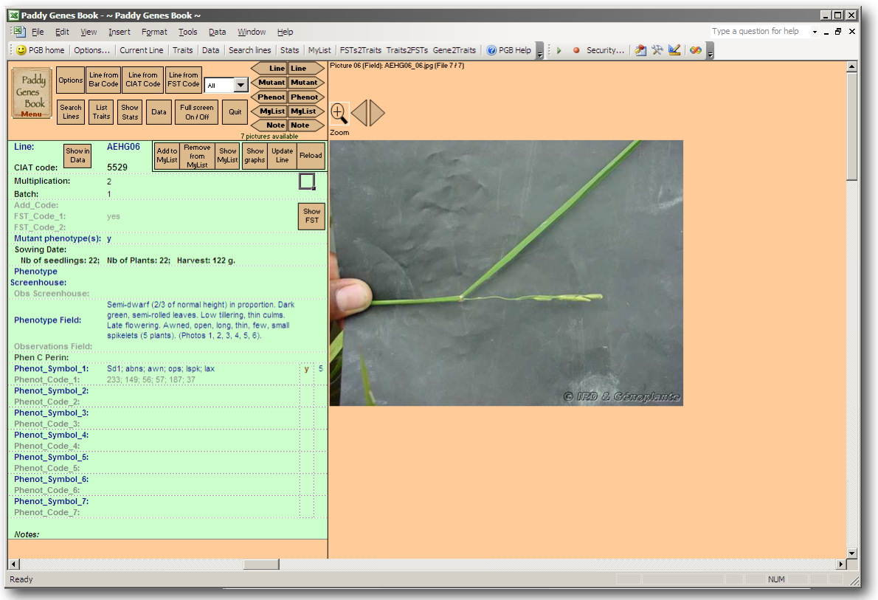
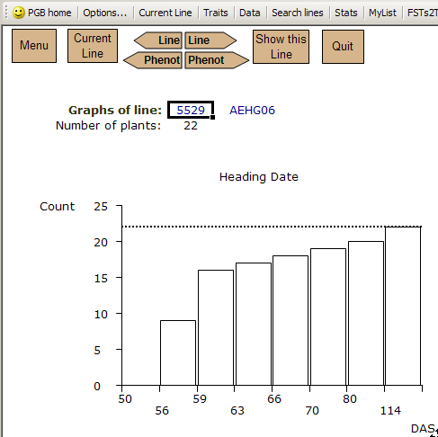
DETAILED DISPLAY OF LINES

Slide 22
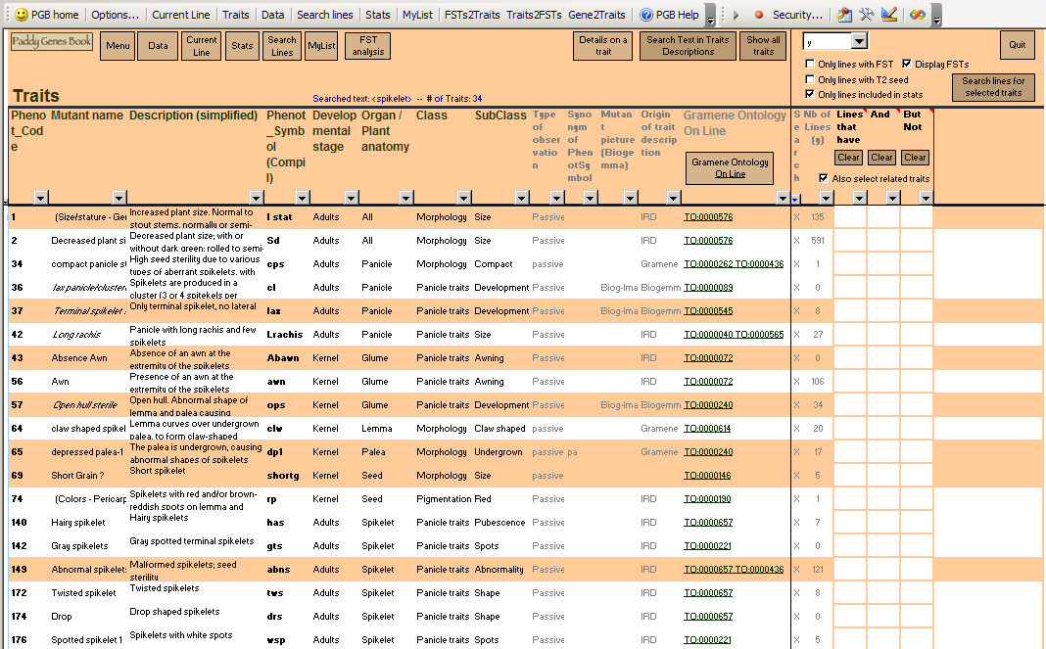
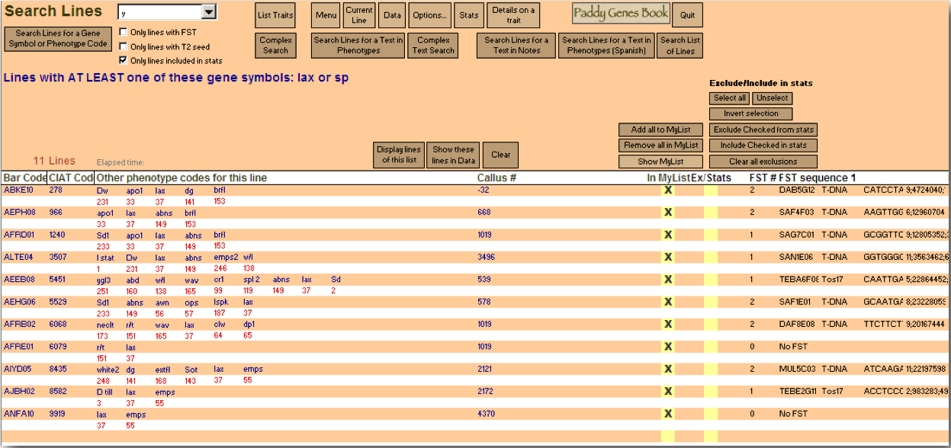
TRAIT SEARCH

Slide 23
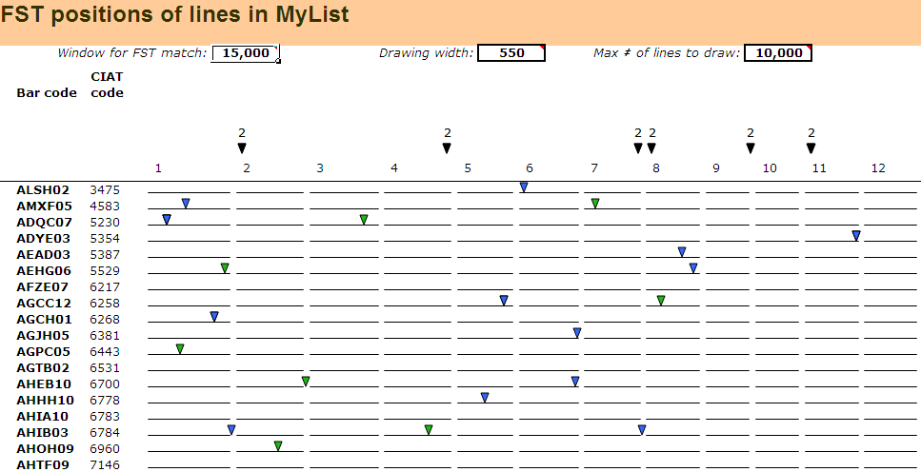
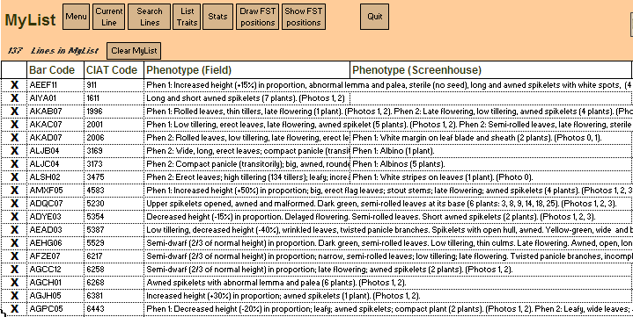
MYLIST

Slide 24
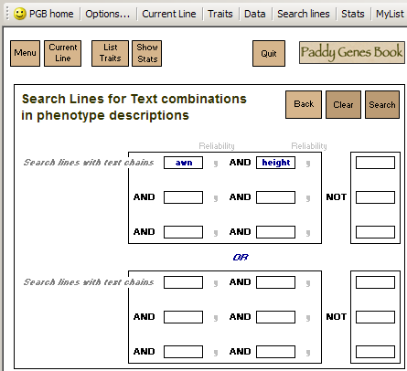
COMPLEX SEARCH (TEXT)

Slide 25
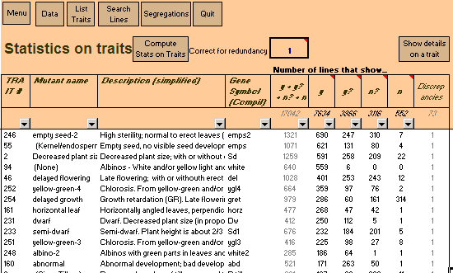
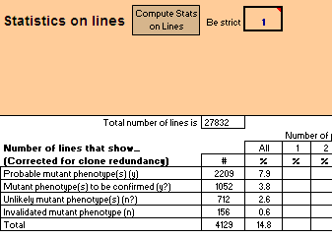
STATISTICS ON TRAITS AND LINES

Slide 26
STATS ON TRAITS PER ORGAN
Organ | # mutant phenotypes
Leaf | 1428
Panicle | 650
Endosperm, Seed | 621
Culm | 324
Flag leaf | 173
Spikelet | 169
Glume | 144
Hull, Internode | 92
Panicle, Leaf | 49
Root | 22
Leaf, culm | 21
Leaf, Panicle | 21
Lemma | 20
Palea | 17
Seed | 11
Panicle, spikelet | 4
Ligule | 1
Entire plant | 3867

Slide 27
SEGREGATION
Mutant name | Nb Dom | Nb Rec | Total
empty seed-2 | 574 | 365 | 939
empty seed | 242 | 351 | 593
albino | 105 | 531 | 636
semi-dwarf | 98 | 721 | 819
yellow-green-4 | 56 | 249 | 305
horizontal leaf | 53 | 60 | 113
yellow-green-3 | 52 | 223 | 275
delayed flowering | 43 | 457 | 500
dwarf | 24 | 280 | 304
horizontal fl. | 20 | 20 | 40
semi-dwarf | 19 | 336 | 355
giant | 19 | 134 | 153
wide / long leaves | 15 | 42 | 57
albino-2 | 14 | 189 | 203

Slide 28
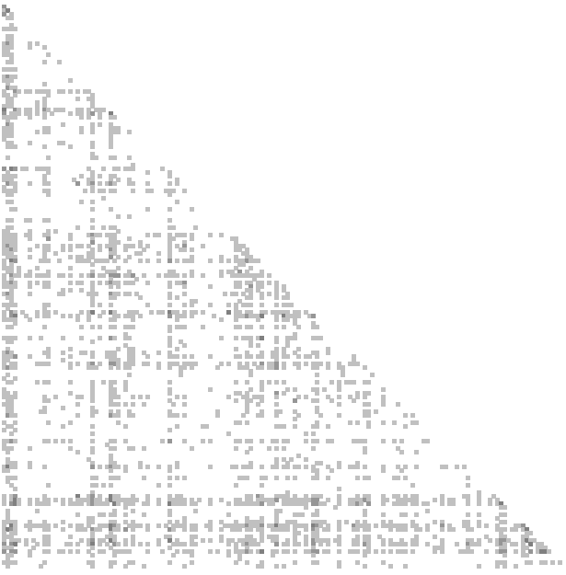
TRAIT CO-OCCURRENCES

Slide 29
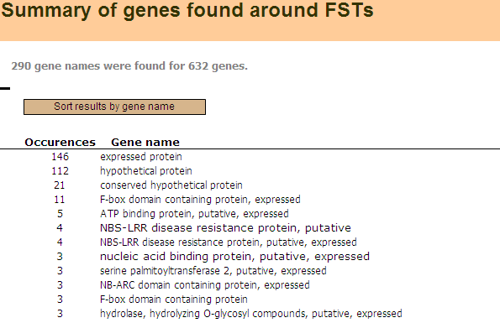
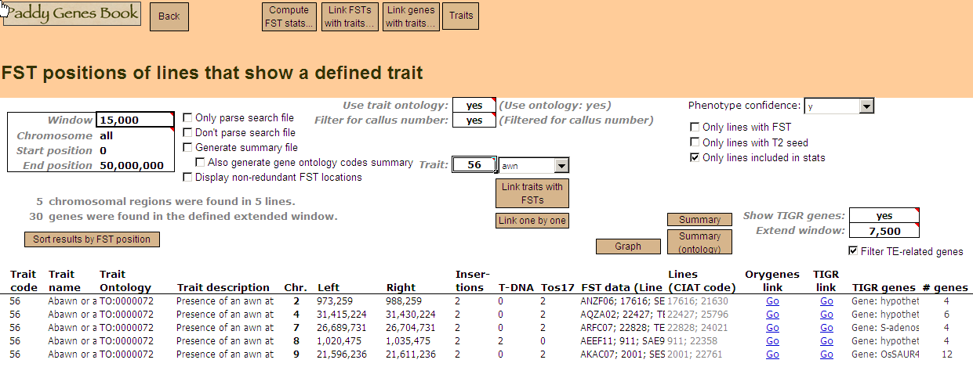
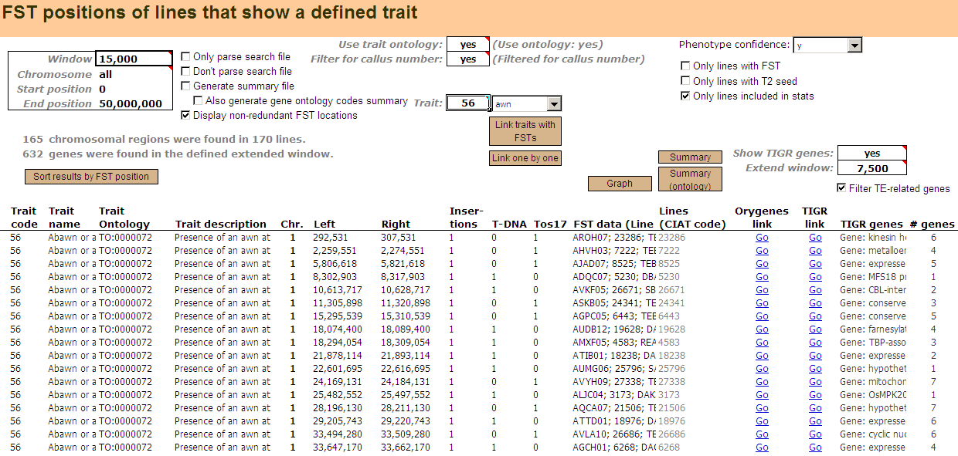
LINK TRAITS TO FSTS

Slide 30
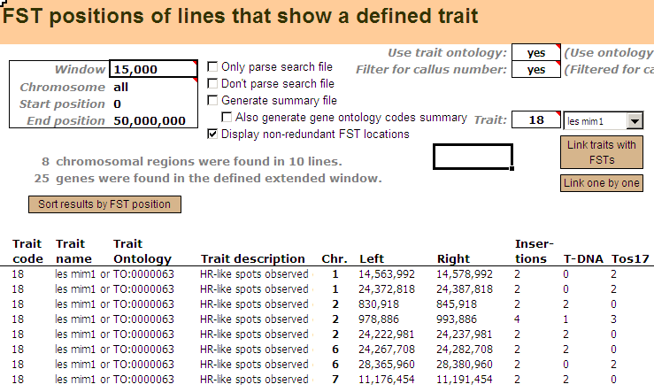
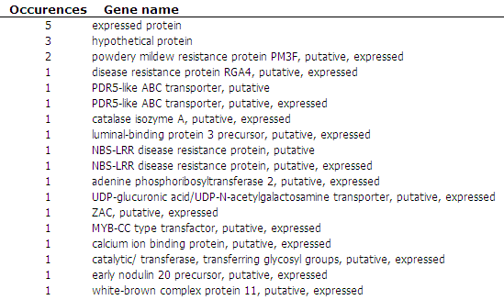
EXAMPLE: LESION MIMICS

Slide 31
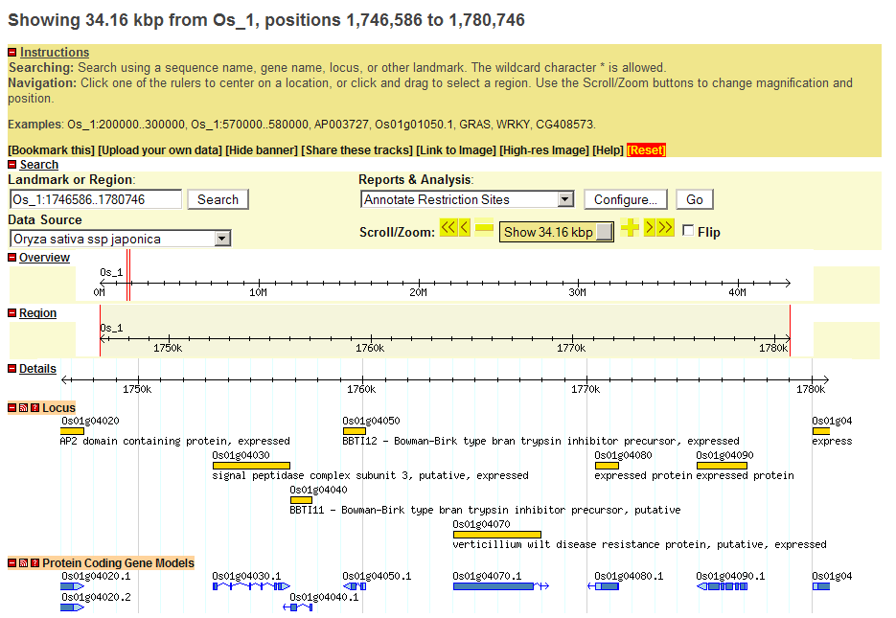
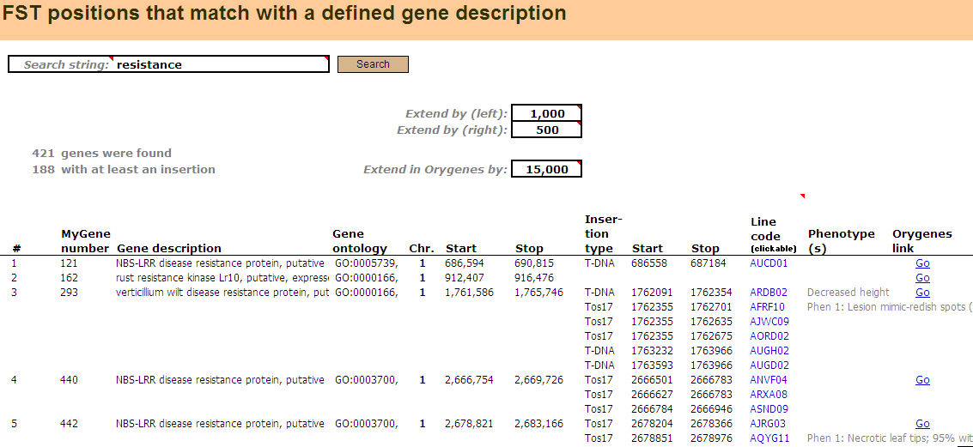

GENE2TRAITS

Slide 32




GENE2TRAITS

Slide 33



GENE2TRAITS

Slide 34
IN BRIEF
28,000 lines were phenotyped
Link phenotypes to FSTs for fast identification of candidate genes
All data in both PaddyGenesBook and Oryza Tag Line
Seed increase & storage
Contribution to the effort made by the International Rice Functional Genomics Consortium (IRFGC)
Several laboratories working on the OTL lines
INRA, IRD, Cirad
Open to collaborations

Slide 35



AVAILABILITY
PaddyGenesBook available soon at http://mapdisto.free.fr/PaddyGenesBook
Oryza Tag Line http://urgi.versailles.inra.fr/OryzaTagLine

Slide 36
INCREASE T-DNA LINES EFFICIENCY
T-DNA and Tos17 sequencing do not provide the full information on mutations
Forward approach starting from key phenotypes
Identify phenotypic mutants
Re-sequence mutants to evidence genomic changes
Correlate with phenotype
VALIDATE THE TOOL
Compile all cloned genes and QTLs
Include into gene2trait analysis
Compare to unidentified genes and QTL positions

Slide 37
They did the work
CIAT:
J. Lozano
M. Bouniol
S. Acosta
L. Motato
M. Brito
V. H. Lozano
E. Robayo
J. Tigreros
E. Armero
DAP Unit:
E. Guiderdoni
D. Mieulet (Cirad)
C. Gay (INRA)
M. Portefaix (INRA)
IRD:
A. Ghesquière
T. Mathieu
Special thanks to:
J. Tohme (CIAT)
P. Perez (Biogemma)
Genoplante
Agence Nationale de la Recherche (ANR)

Slide 38


